Slide 1

LITERATURE REVIEW
PETDOC PROJECT
Smart Veterinary Care System with AI-Based Disease Detection
Group: 05
Members: Rishat Bin Sultan, Fariha Islam, MD Tamim Hasan
Group 05 | Rishat Bin Sultan, Fariha Islam, MD Tamim Hasan

Slide 2
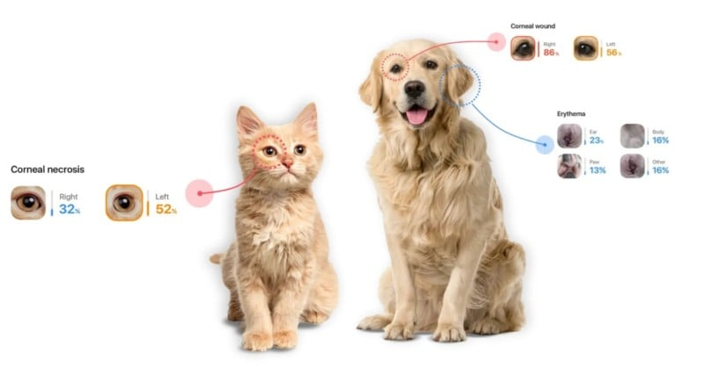


PROJECT OVERVIEW
Meet PetDoc: The Future of Pet Healthcare
AI Disease Detection
E-Commerce Platform
24/7 Consultation
Get preliminary disease guidance by selecting symptoms or uploading pet images for instant AI analysis.
Browse and purchase veterinary products, medicines, and pet care essentials online with seamless delivery.
Access round-the-clock online veterinary support and expert advice whenever you need it.
One Platform. Complete Care. Smarter Decisions.
Group 05 | Rishat Bin Sultan, Fariha Islam, MD Tamim Hasan

Slide 3

MARKET CONTEXT
Digital Healthcare Revolution
Human Healthcare
Digital technology has revolutionized human medical services with telemedicine, AI diagnostics, and integrated health platforms.
Veterinary Care
Key Drivers
Similar advancements are now gradually being adopted in animal healthcare, creating new opportunities for innovation.
Mobile Access
Smartphone-based healthcare solutions
The Growing Trend
AI Integration
Pet owners increasingly seek digital solutions for their animals' health
Machine learning for disease detection
24/7 Availability
Round-the-clock veterinary support
Group 05 | Rishat Bin Sultan, Fariha Islam, MD Tamim Hasan

Slide 4

LITERATURE REVIEW
Existing Systems
M. S. Hossain et al. (2020) - Web-Based Veterinary Care System
Record Management Focus
Digital record keeping for patient history and medical data
Appointment scheduling to reduce clinic workload
Administrative efficiency improvements
The Missing Piece
No AI Features
No Disease Prediction
Clinic-Centered
Traditional veterinary management systems focus on clinic operations and administrative tasks.
Lacks ML or AI-powered diagnostic capabilities
No automated diagnostic support for pet owners
Designed primarily for veterinary staff and clinic operations, not direct pet owner engagement.
Group 05 | Rishat Bin Sultan, Fariha Islam, MD Tamim Hasan

Slide 5
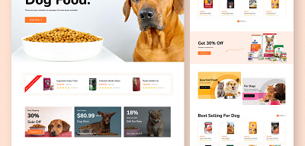
LITERATURE REVIEW
Veterinary E-Commerce
J. Smith & A. Doe (2022) - Trends in Veterinary E-Commerce Platforms
Product Accessibility Without Intelligence
Pet Food
Medicines
Accessories
Specialized diets
Prescription & OTC
Toys & grooming
Rapid Growth
What's Missing?
Symptom analysis capabilities
Disease detection features
Online marketplaces have improved product accessibility significantly
Medical guidance integration
Healthcare intelligence
Critical Gap
These platforms lack healthcare intelligence features such as symptom analysis, disease detection, and medical guidance.
Group 05 | Rishat Bin Sultan, Fariha Islam, MD Tamim Hasan

Slide 6
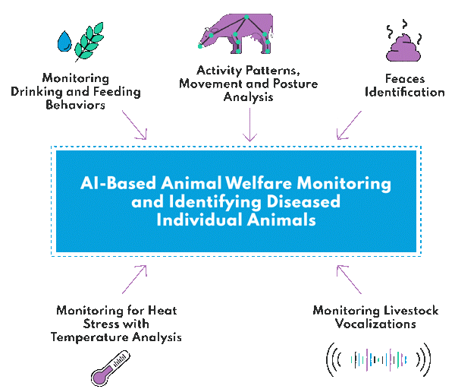
LITERATURE REVIEW
AI in Animal Disease Detection
R. Kumar & S. Singh (2021) - ML Techniques Review
Classification Algorithms
Early Stage Detection
Successfully predict diseases using symptom-based data analysis
ML models can identify diseases before severe symptoms appear
Research Environment
Models tested in controlled settings with limited datasets
No User Access
Pet owners cannot directly interact with these AI systems through consumer-friendly platforms.
The Problem
These systems remained mostly experimental and were not integrated into real-world consumer platforms.
Key Insight: Research needs to bridge the gap to practical deployment
Group 05 | Rishat Bin Sultan, Fariha Islam, MD Tamim Hasan

Slide 7
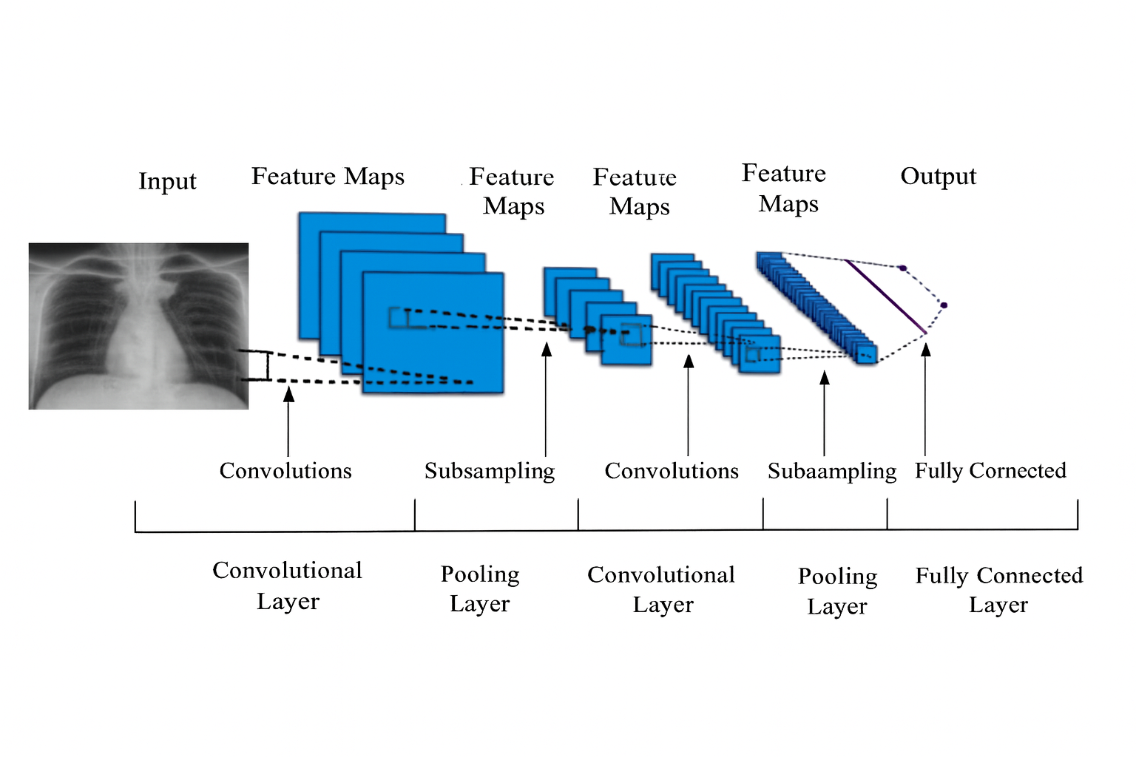
LITERATURE REVIEW
Deep Learning for Image Diagnosis
T. K. Dash & S. Mishra (2023) - CNNs for Automated Skin Disease Detection
CNNs for Skin Disease Detection
Image-Based Analysis
Proven Effectiveness
High Accuracy
Uses pet images to detect skin diseases automatically
Deep learning techniques are highly effective for image-based veterinary diagnosis
Achieved impressive results proving CNN effectiveness
Domestic Animals
Focused on common household pets, making the research directly applicable to PetDoc's target users.
Deployment Gap
Research focused mainly on model performance without addressing deployment in user-friendly online systems.
Missing Link
No connection to consumer platforms where pet owners can easily access these tools.
Group 05 | Rishat Bin Sultan, Fariha Islam, MD Tamim Hasan

Slide 8
RESEARCH ANALYSIS
The Research Gap
Fragmented Solutions
Current veterinary platforms focus on only one aspect of care rather than providing a complete integrated solution.
Record Management
E-Commerce Only
Standalone AI
Systems like Hossain et al.'s focus only on administrative tasks and appointment scheduling.
Platforms like Smith & Doe studied are just online shops without healthcare intelligence.
Kumar & Singh, Dash & Mishra developed experimental models without user integration.
No AI Features
No Medical Guidance
No Platform Access
Clear Gap: No unified system combining all these essential features!
Group 05 | Rishat Bin Sultan, Fariha Islamz, MD Tamim Hasan

Slide 9
SOLUTION REQUIREMENTS
What's Missing?
A Unified Approach is Needed
Current systems lack integration of these essential components for comprehensive pet healthcare:
AI Disease Detection
Online Purchasing
Image and symptom-based machine learning models for preliminary disease identification and guidance.
Seamless e-commerce functionality for veterinary products with direct medicine recommendations based on diagnosis.
24/7 Consultation
Product Integration
Round-the-clock online veterinary support for expert advice and emergency guidance.
Direct product links from diagnosis to recommended medicines and care products.
All these features must work together in ONE unified platform!
Group 05 | Rishat Bin Sultan, Fariha Islam, MD Tamim Hasan

Slide 10
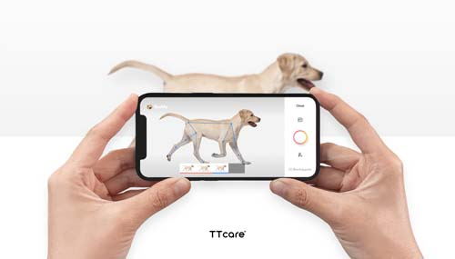
THE SOLUTION
PetDoc: Bridging the Gap
Unified Platform Features
PetDoc integrates e-commerce functionality with machine learning-based disease detection in a single user-friendly web platform.
E-Commerce
AI Diagnosis
Consultation
Smart recommendations
Symptom & image-based
24/7 online support
Practical & Deployable
A real-world solution to modern veterinary healthcare challenges, not just theoretical research.
What Makes PetDoc Different
User-Centered
Integrated
24/7 Access
User-centered design focused on pet owners, not just clinics
Real-world deployment of AI models for actual use
Accessible platform available 24/7 for all pet owners
Group 05 | Rishat Bin Sultan, Fariha Islam, MD Tamim Hasan

Slide 11
CONCLUSION
Key Takeaways
Research Insights
Digital healthcare is rapidly transforming veterinary services
Existing solutions are fragmented and incomplete
🐾
AI/ML techniques are proven effective but not deployed
PetDoc = Complete Care
Clear research gap exists for unified platforms
PetDoc's Contribution
AI Intelligence
E-Commerce
24/7 Support
Bridges the gap between research and real-world application
Integrates all essential features in one platform
Thank You!
Questions & Discussion
User-centered approach for pet owner accessibility
Practical solution to modern veterinary challenges
Group 05 | Rishat Bin Sultan, Fariha Islam, MD Tamim Hasan

